Slide 1
03.06.2019
Julio Merette

Slide 2
Agenda
1. machineQ Network Architecture
2. ST LoRa Dev Kit overview
3. mQ Central – Network Management Portal
4. let’s play!!!

Slide 3
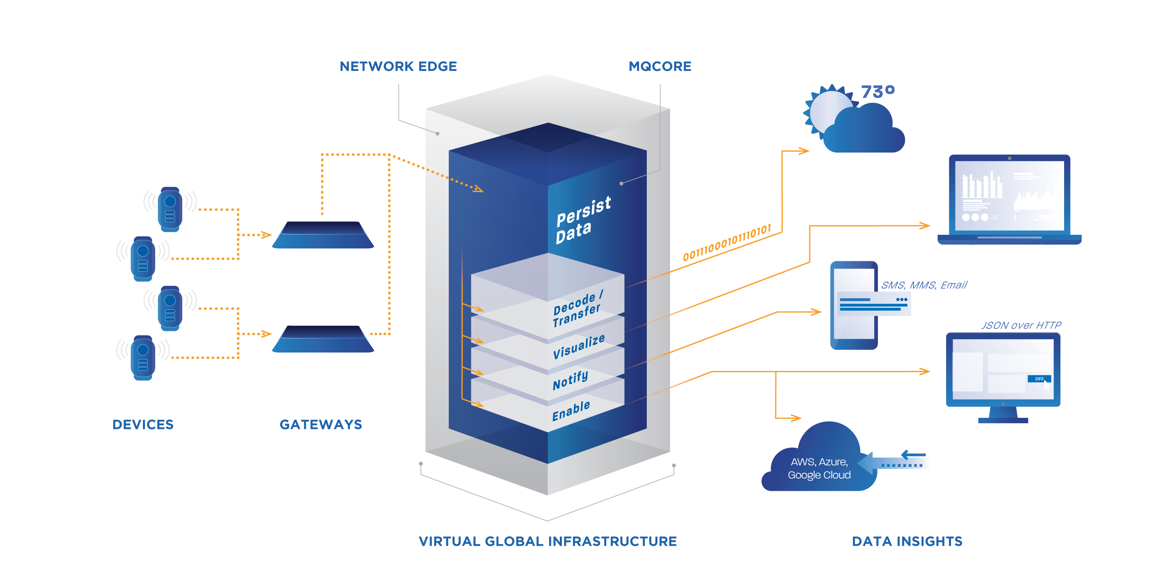
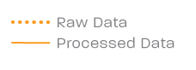
HOW WE DO IT: A COMPREHENSIVE SOLUTION
COMCAST CONFIDENTIAL

Slide 4
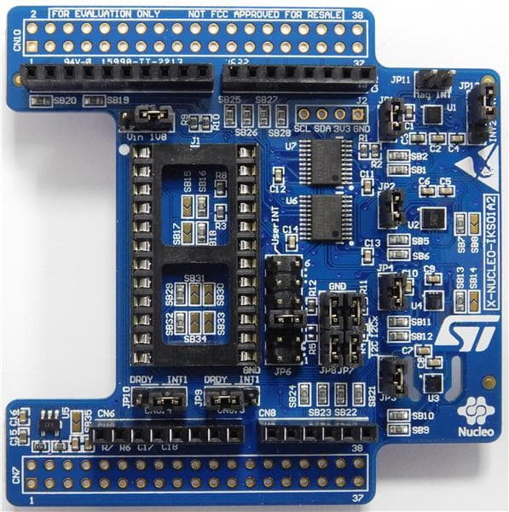
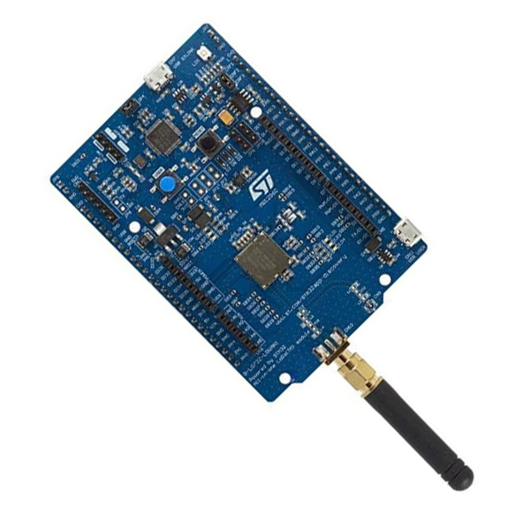
ST LoRa Dev Kit
CMWX1ZZABZ-091 LoRa® module (Murata)
Embedded ultra-low-power STM32L072CZ Series MCUs, based on Arm® Cortex®-M0+ core, with 192 Kbytes of Flash memory, 20 Kbytes of RAM, 20 Kbytes of EEPROM
Frequency range: 860 MHz - 930 MHz
USB 2.0 FS
Embedded SX1276 transceiver
+14 dBm or +20 dBm selectable output power
Board power supply:
Through USB bus or external V_{IN}/3.3 V supply voltage or batteries
7 LEDs
2 push-buttons (user and reset)
Arduino™ Uno V3 connectors
Arm® Mbed™ (see http://mbed.org)
And More…..

Slide 5
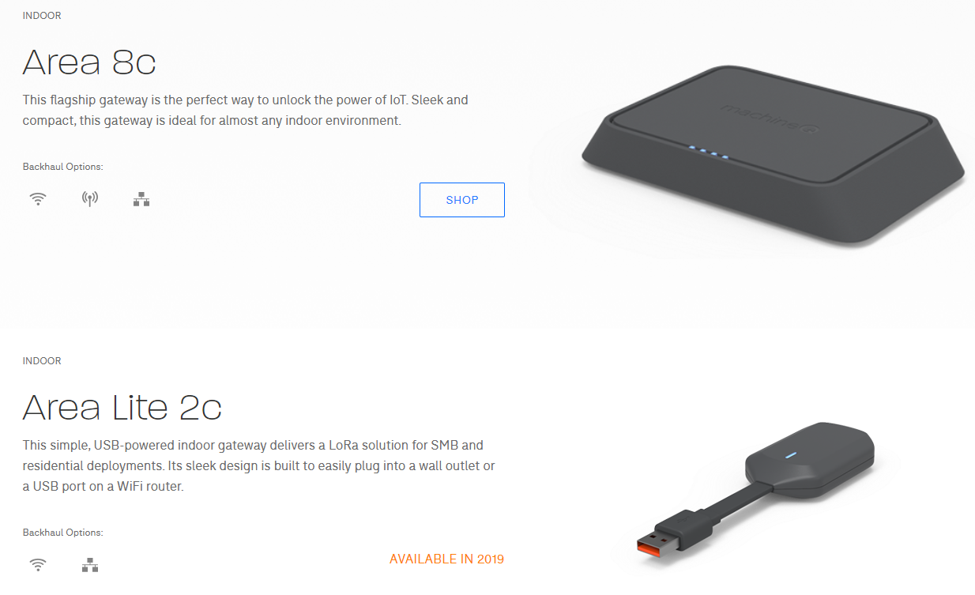
Indoor Gateways

Slide 6
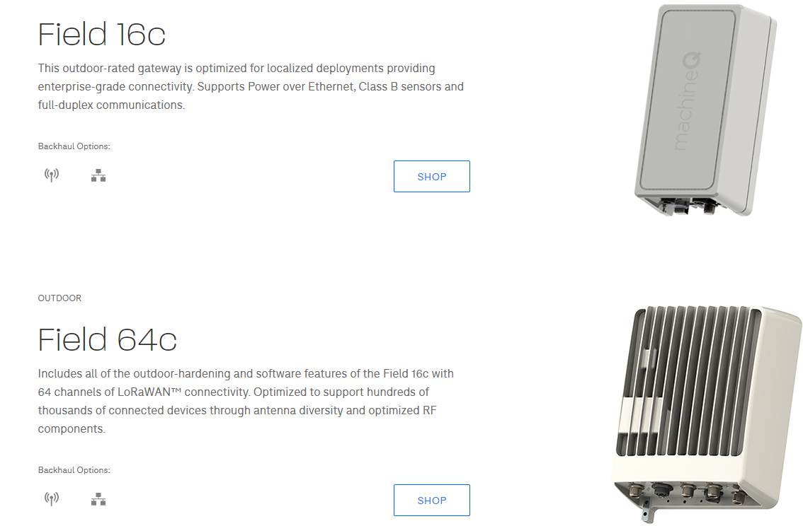
Outdoor Gateways

Slide 7
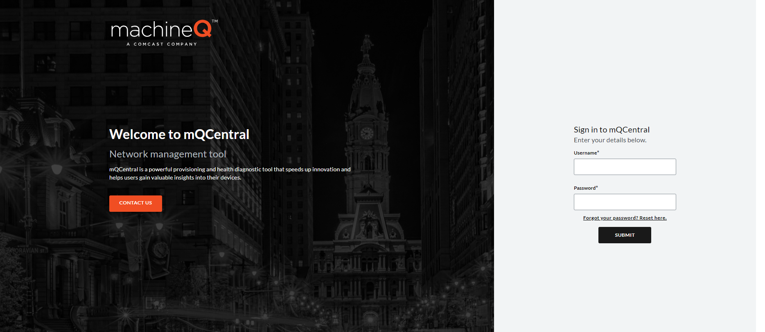

Slide 8

https://github.com/beous/Lora-Bootcamp-machineQ

Slide 9

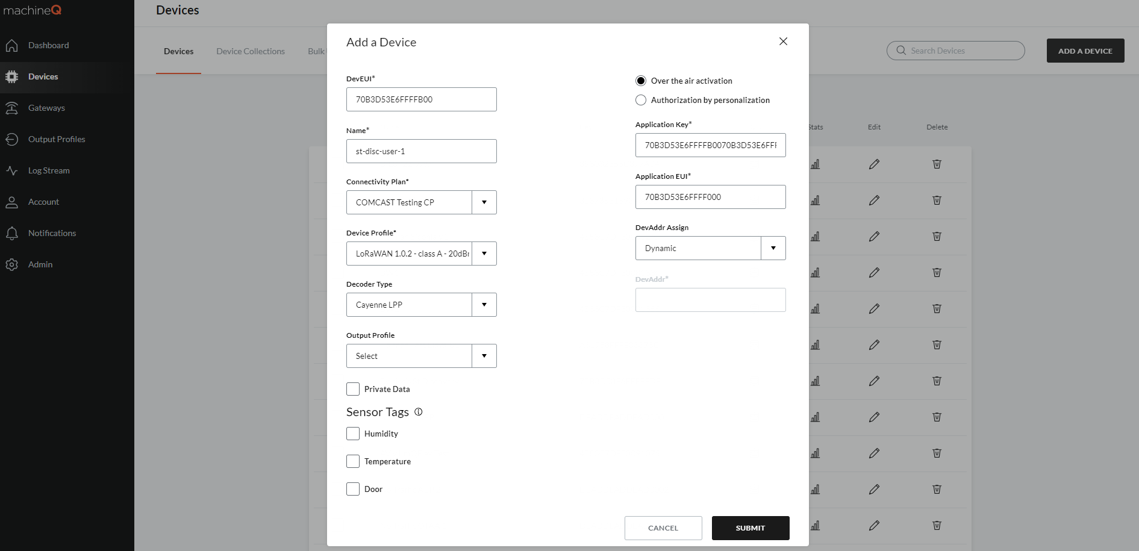
mQ Central Device Configuration
2
1
4
3
Device DevEUI
5
Name
Connectivity Plan:
COMCAST Testing CP
Device Profile:
LoraWAN1.0.2 ClassA 20dBm FCC RX2 SF12
Decoder: Cayenne LPP
6

Slide 10
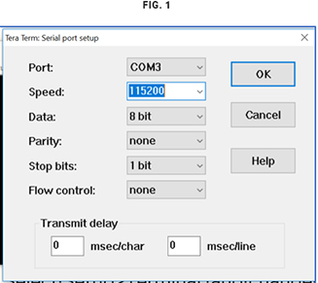
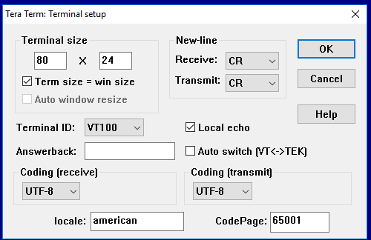
Setting Up the ST LoRa Dev Kit Board
Plug the provided micro-USB into the CN7 USB STLINK port on the ST Discovery board and into your computer.
Download the binary file here.
Open FileExplorer and click This PC. Scroll down to Devices and Drives. The board will appear as a drive.
Drag the binary file into the drive, and wait for the transfer to finish. The LD5 LED light will blink on the board.
Set up TeraTerm (or your terminal of choice):
Launch the application.
Select the Serial radio button and choose your port from the drop-down menu.
Select Setup>Terminal, and change the settings to the those in Fig. 1
Select Setup>Serial Port, and change the Speed (the baud rate) to the those in Fig. B for the appropriate Port.
Press the black RESET button on the board, which should prompt you to enter the credentials from machineQ.

Slide 11
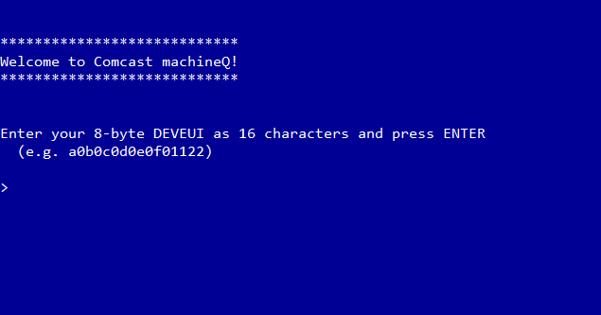

Setting Up the ST LoRa Dev Kit Board
Enter your DevEUI, AppEUI and AppKey
Enter your transmit duty cycle in mS
Reset

Slide 12
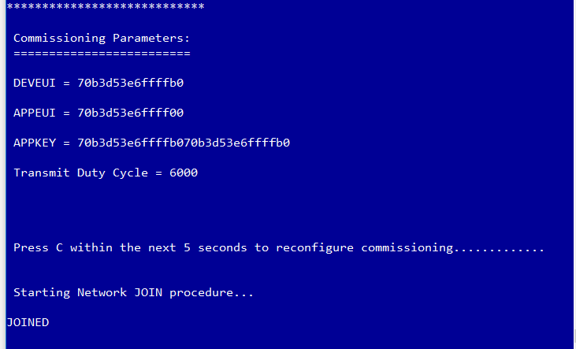
Test
1. Confirm the ST Discovery JOINED the Network

Slide 13
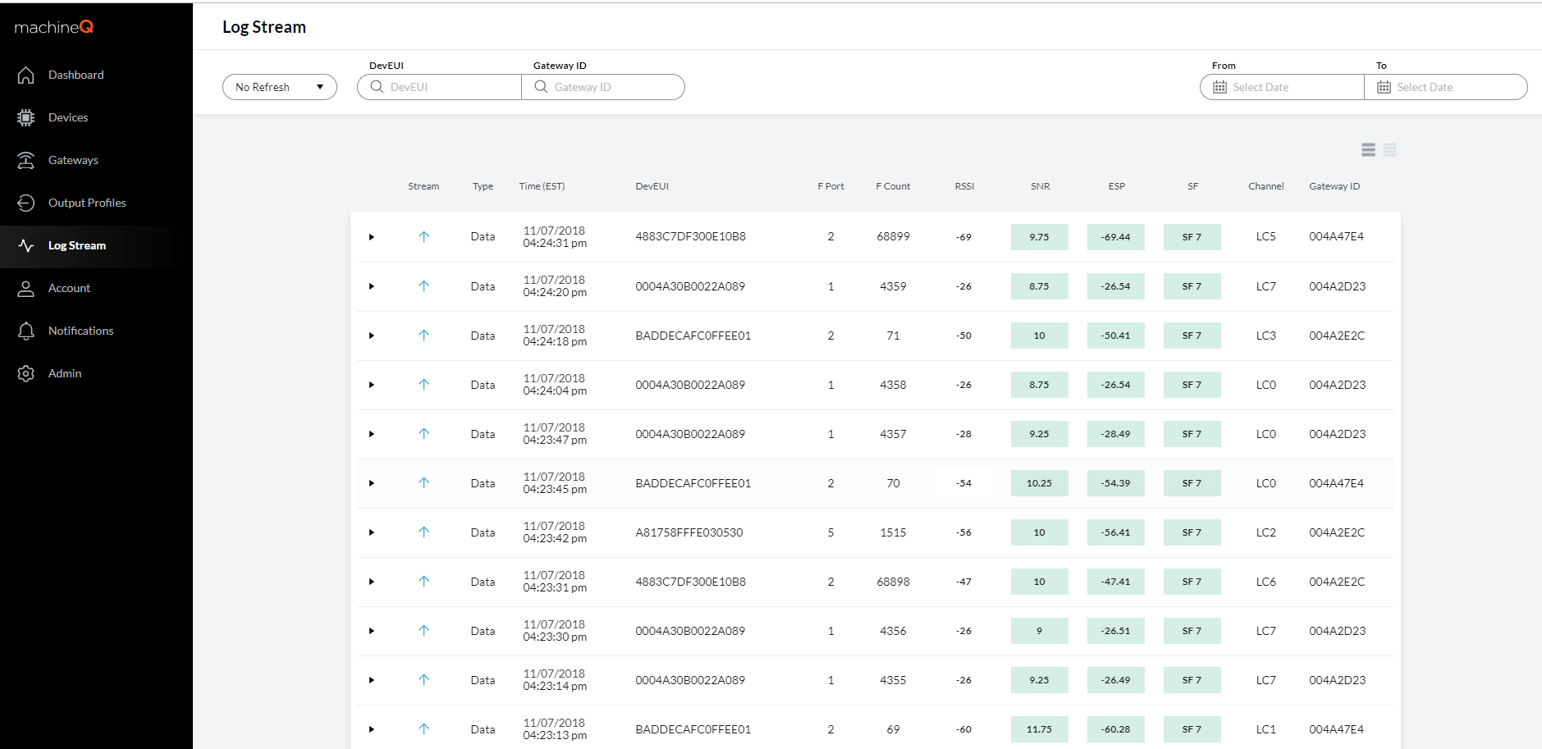
Test
2. Go to mQ Central -> Wireless Logger to confirm the reception of the uplink messages

